Slide 1
Docker Image Deployment In Kubernetes

Slide 2
Steps to Deploy Docker Image to Kubernetes
Creating a Dockerfile
Building an Image from Dockerfile
Validate if the Image is created and Listed
Optionally upload to Docker Hub to share with the world
Start the Container from Image
Open the minikube dashboard and check the deployment of the docker image

Slide 3
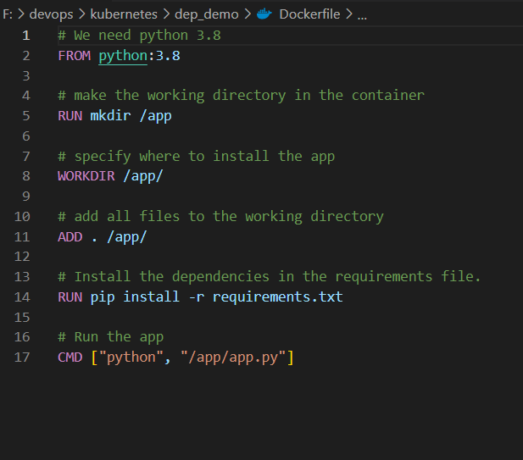
Creating a Dockerfile

Slide 4
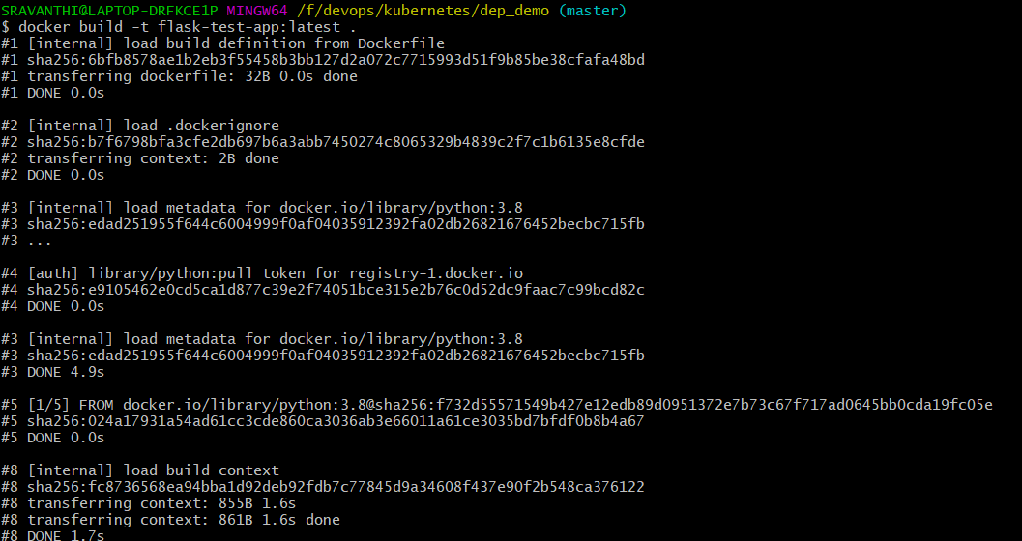
Building an Image from Dockerfile

Slide 5
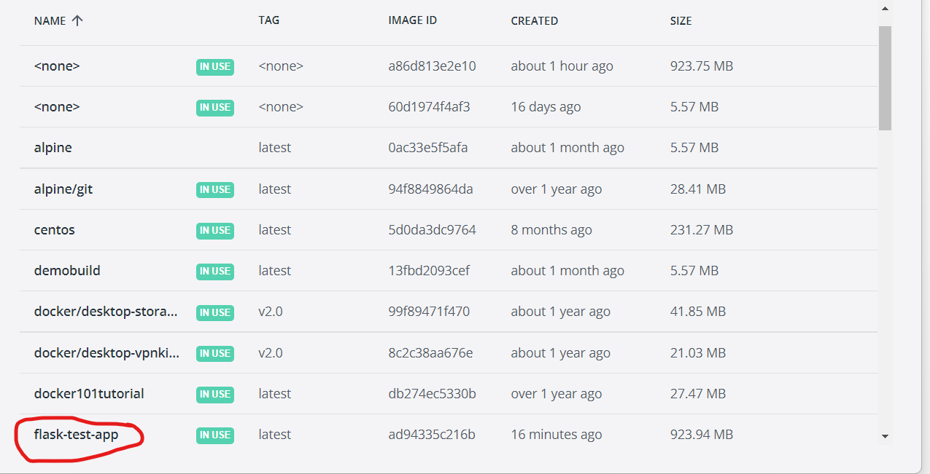
Validate if the Image is created and Listed

Slide 6
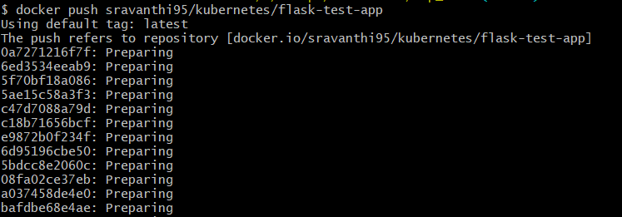
Optionally upload to Docker Hub to share with the world

Slide 7
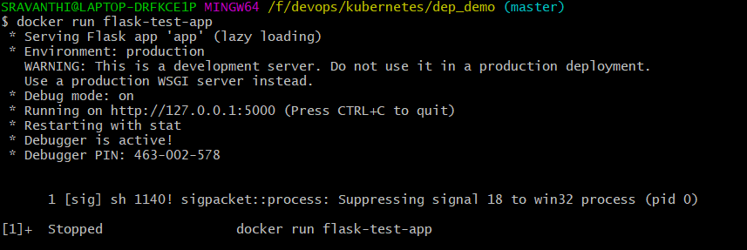
Start the Container from Image

Slide 8
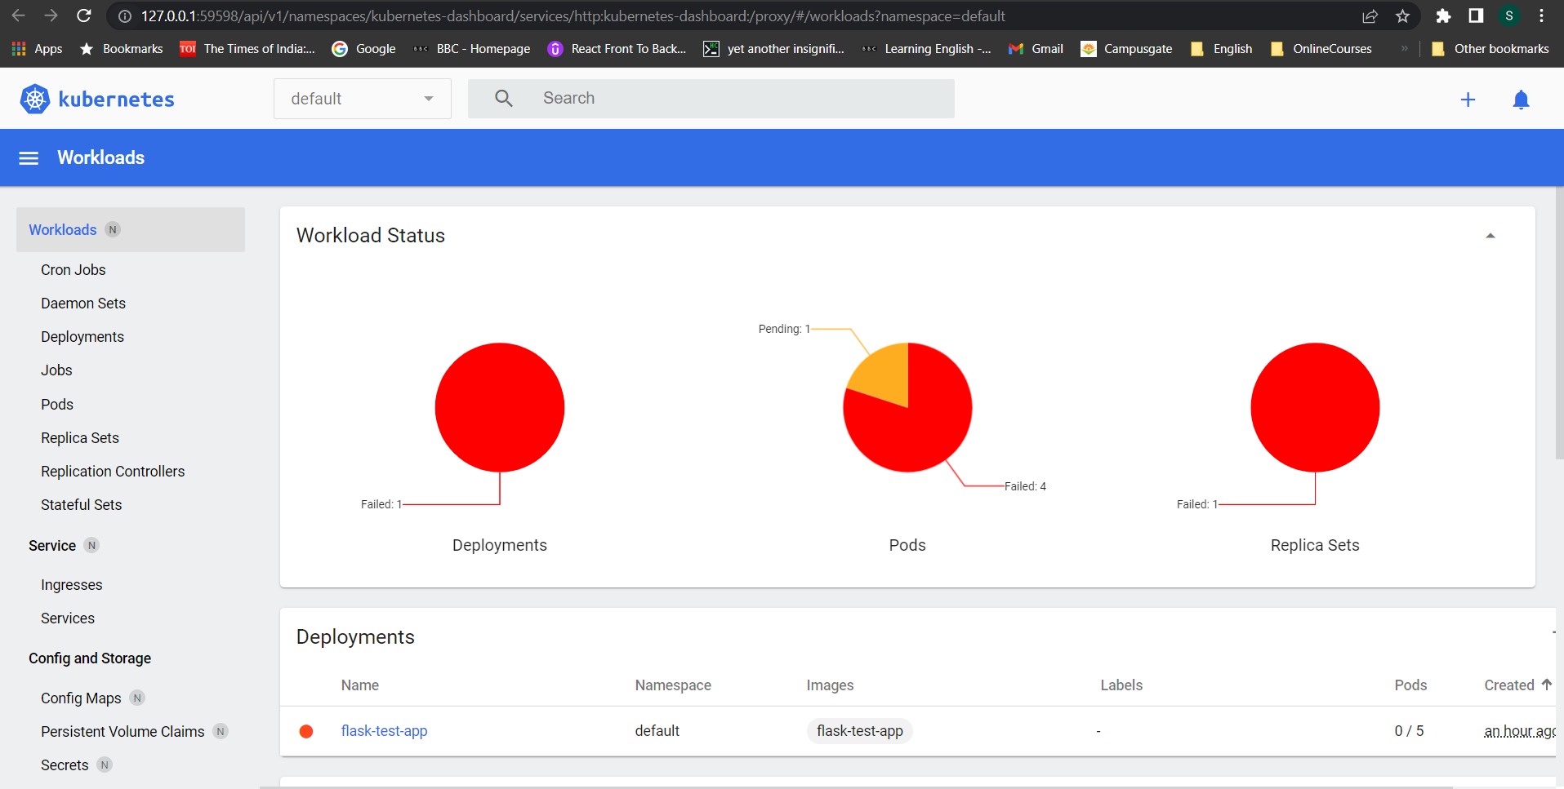
Open the minikube dashboard and check the deployment of the docker image

Slide 9


